Slide 1

A Closer Look at Deaths due to Cerebrovascular Disease in New Jersey by Gender
By Megha Ravi

Slide 2
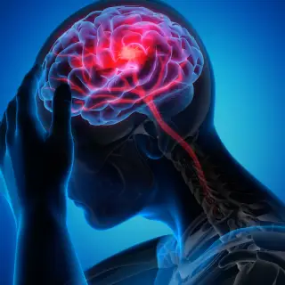
What is Cerebrovascular Disease?
Cerebrovascular diseases: “a range of conditions that affect the blood vessels (vascular system) in the brain and spinal cord1
examples: stroke, brain aneurysm, Carotid Artery Disease, Moyamoya Disease, etc1
5th leading cause of death in U.S.(2022)2
“stroke is a leading cause of serious long term disability”3
Risk of cerebrovascular disease can be reduced by following a healthy lifestyle4
stroke and brain aneurysm preventable risk factors: smoking, high blood pressure, drug use, and alcohol use 5
Sources:
1. pennmedicine.org
2. cdc.gov
3. aans.org
4. my.clevelandclinic.org
5. mayoclinic.org
Notes:
Some due to older age, genetics, and being female https://www.mayoclinic.org/diseases-conditions/brain-aneurysm/symptoms-causes/syc-20361483

Slide 3
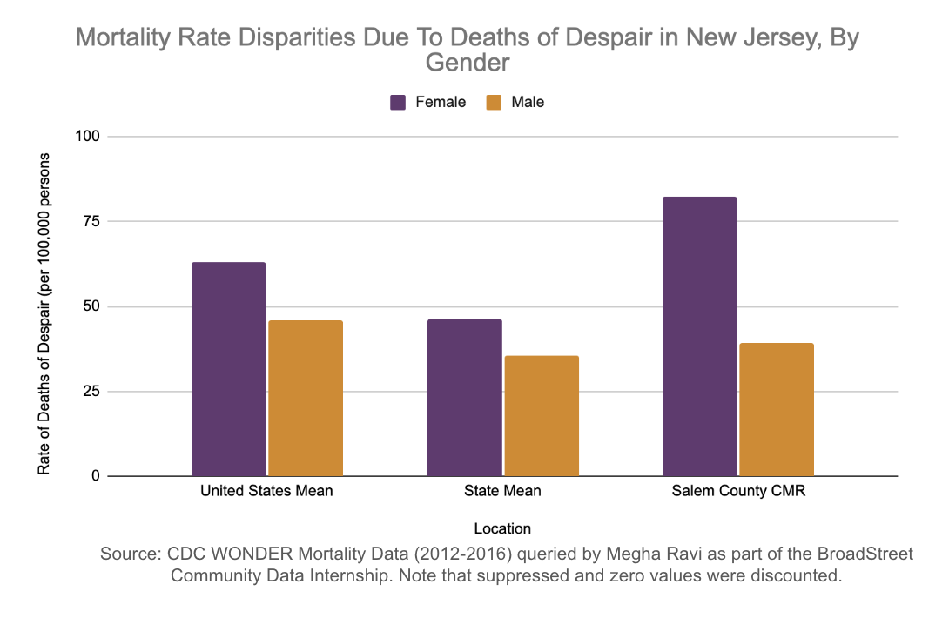
Why advocate for the female population in Salem County?
County with 2nd highest overall crude mortality rate
Cerebrovascular diseases may be more preventable in Salem than Cape May because Cape May is popular retirement area for older people
Highest crude mortality rate for females in NJ was 82.3%(Salem), compared to 66.4% (Cape May) highest for males in NJ (out of all counties)
Women have a higher risk of stroke
55,000 more women than men have a stroke each year
Black women have the highest prevalence of stroke among women
Sources:
CDC WONDER
goredforwomen.org
Notes:
Out of the conditions that are preventable as well
Explain why in notes more why you chose women

Slide 4
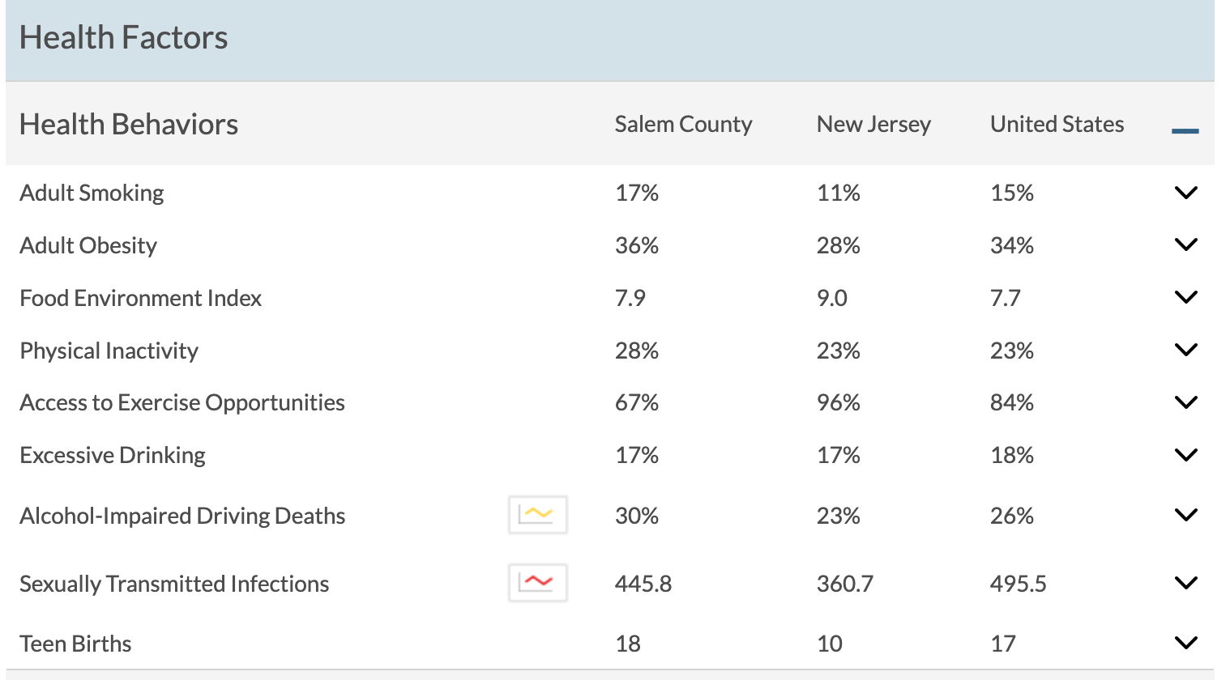
Demographics & Health Factors
Demographics
13.5% Non-Hispanic Black
50.7% Female
53.2% Rural
Health factors:
Adult Smoking
Adult Obesity
Physical Inactivity
Access to Exercise Opportunities
Sources:
countyhealthrankings.org/

Slide 5
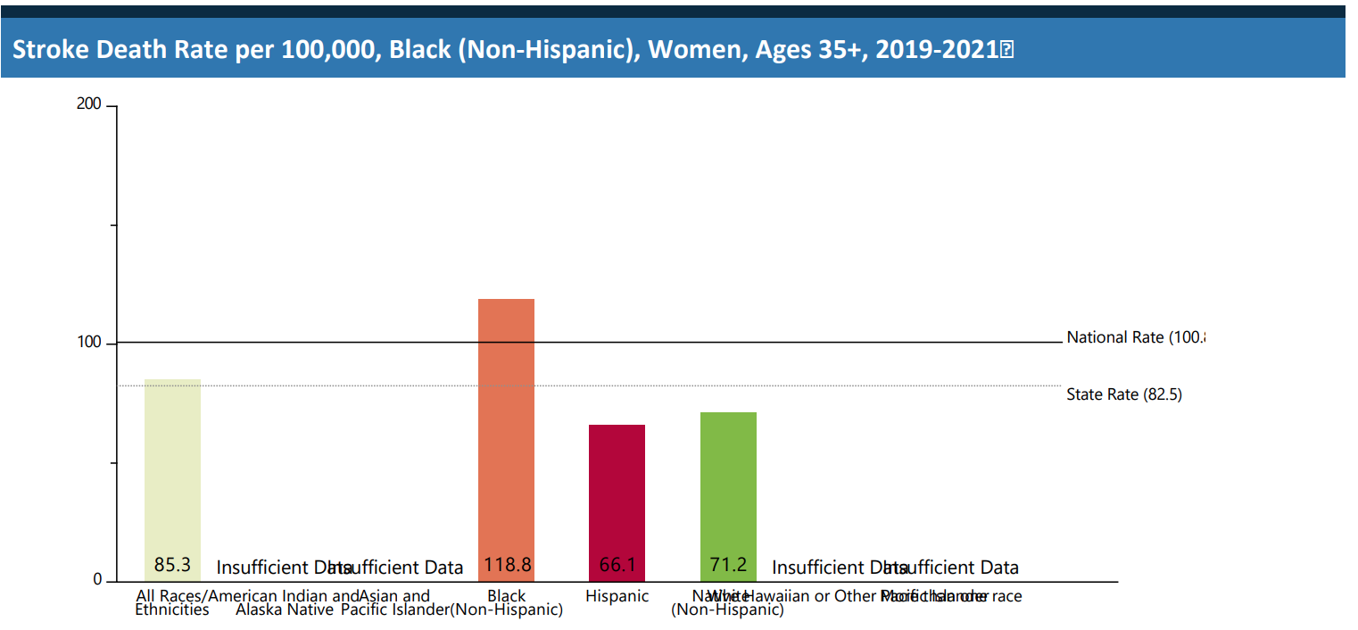
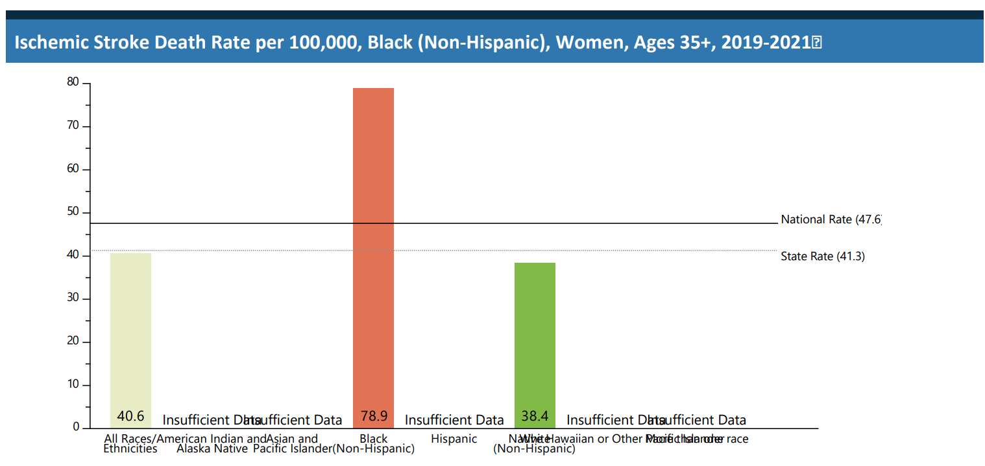
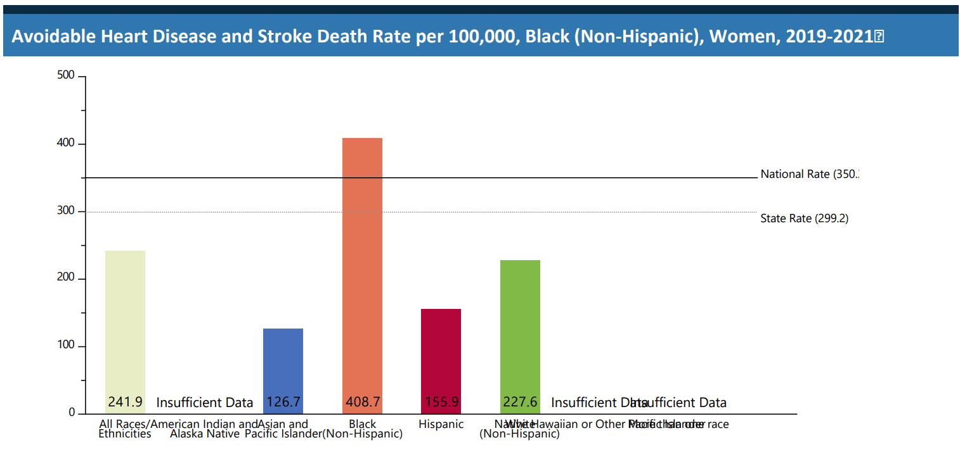
Mortality/Hospitalization
Sources:
https://nccd.cdc.gov/

Slide 6
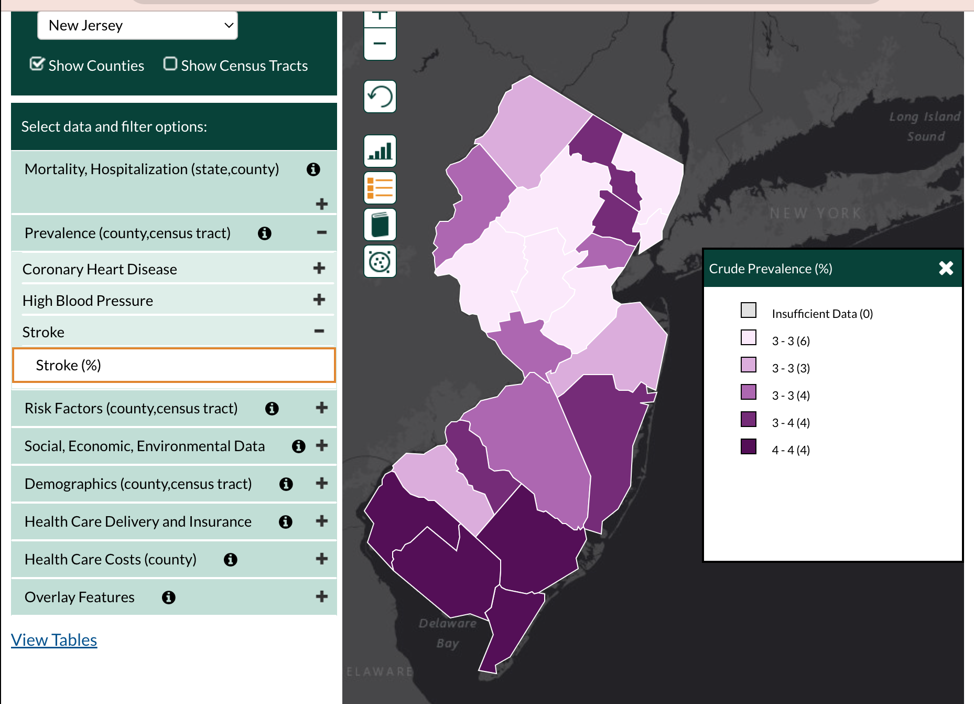
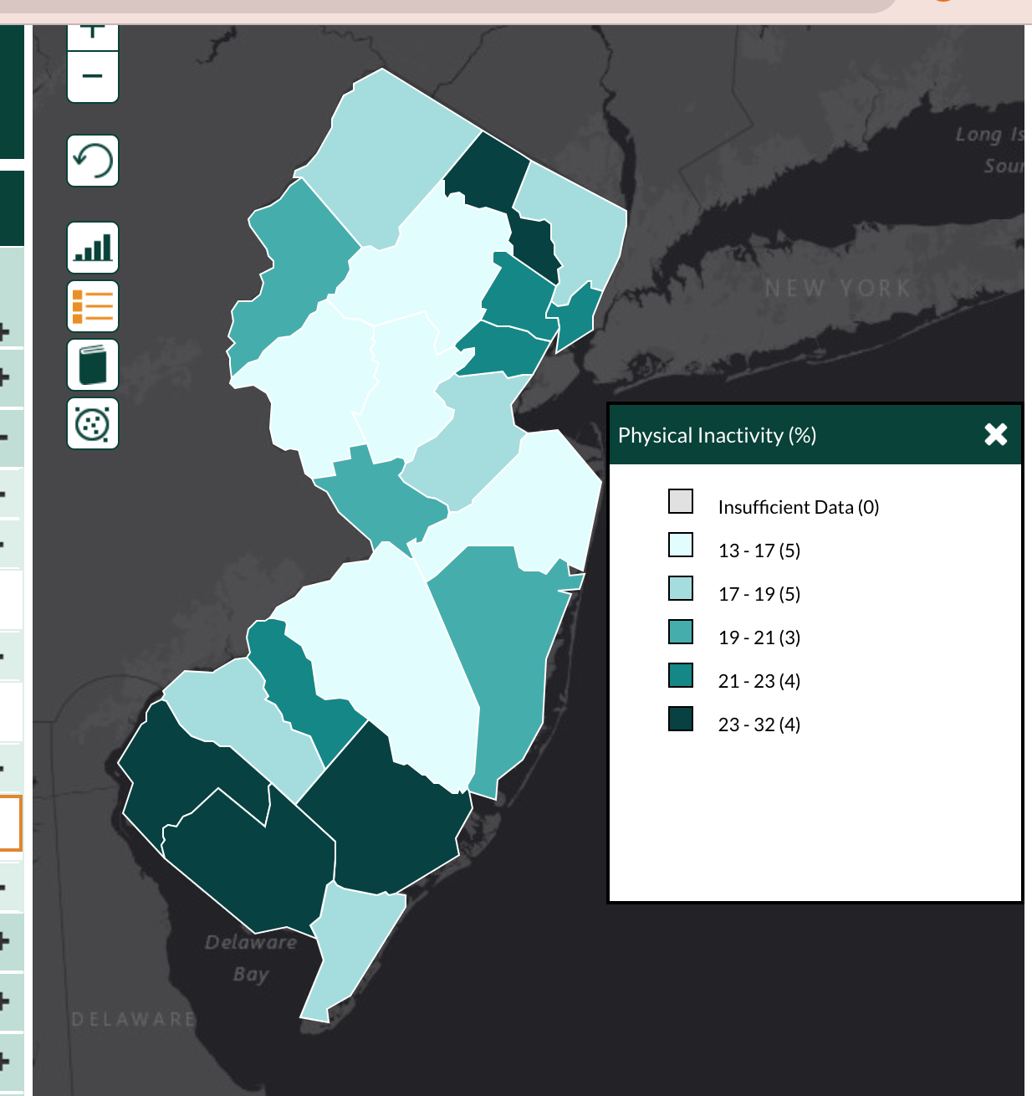
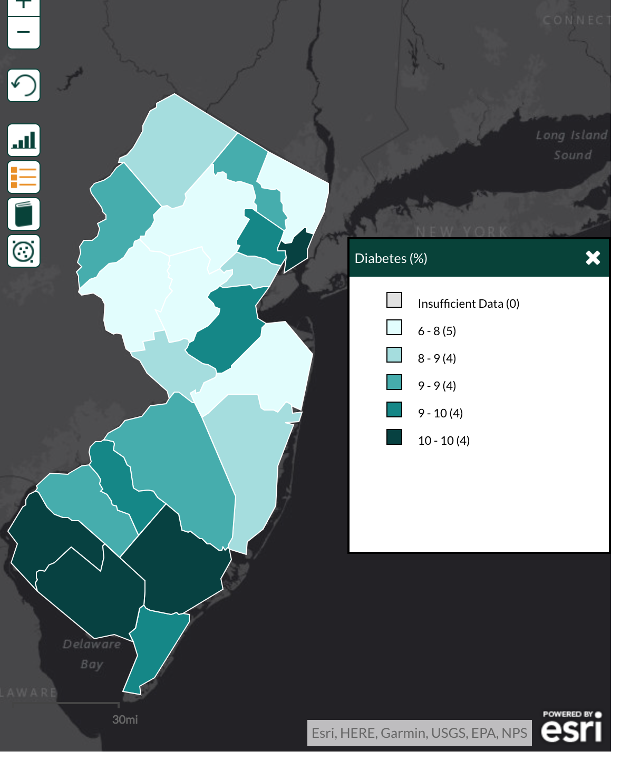
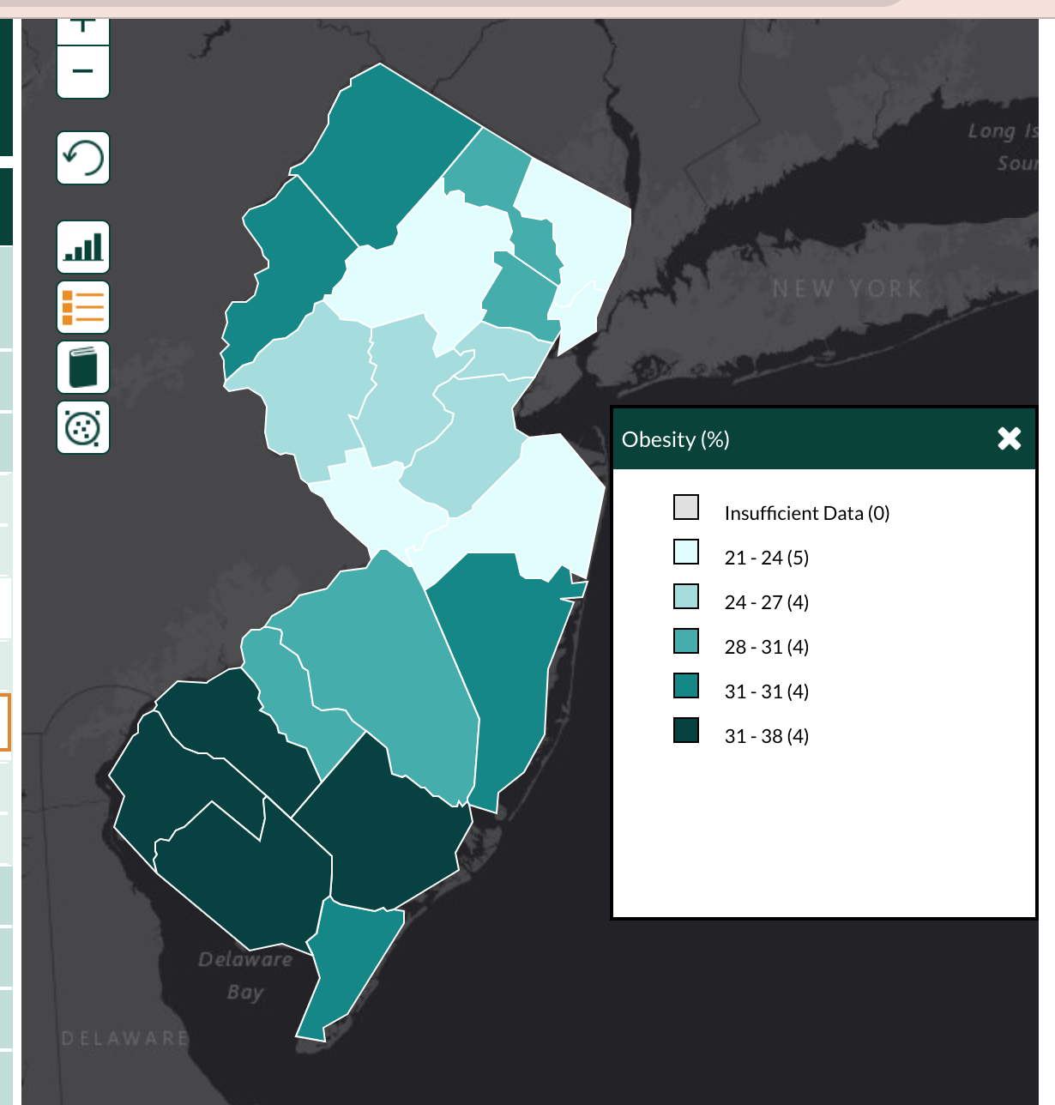
Prevalence and Risk Factors
Stroke Prevalence
Physical Inactivity
Diabetes
Obesity
Sources:
https://nccd.cdc.gov/
Notes:
Add that smoking was also prevalent

Slide 7
Goals
Alarming trends for stroke deaths of women, especially black women
Overall, would recommend reducing smoking rates and more access to physical activity opportunities such as government/county programs by Salem County Department of Health & Human Services
Possible evidence based interventions for improvement:
Increase national average tax on cigarettes
Mass media campaigns and smoke-free policies
Increase muscle-strengthening activity programs (physical activity)
Self-management education programs (diabetes)
Counseling and education on weight reduction, physical activity, nutrition
Sources:
health.gov
Notes:
Add that smoking was also prevalent

Slide 8
Governmental Action
Recent legislation addressing obesity
NJ Bill S2554
Aims to make medications for obesity more accessible to patients diagnosed with obesity
Senate Joint Resolution No. 96
May is designated as “Stroke Awareness Month”
Education to spread awareness of stroke symptoms
New Jersey Heart Disease and Stroke Prevention Program
Senator Cory Booker
Reducing Obesity in Youth Act
Contact information:
Phone: 973 - 639 - 8700
Send a message through his website
Further solutions/legislation:
Investing in exercise-based infrastructure
Access to recreational resources
Sources:
health.gov
nj.gov
https://www.booker.senate.gov/
Notes:
Add that smoking was also prevalent

